Slide 1

Group 6

Slide 2
ADVENTURE WORKS CYCLES ANALYSIS
AGENDA
INTRODUCTION
DASHBOARD
OBJECTIVES : KPIs
ANALYSIS
RECOMMENDATION AND INSIGHT CONCLUSION

Slide 3
Introduction to Adventure Works Cycles
Overview: Adventure Works Cycles is a leading multinational manufacturer of metal
and composite bicycles, serving North American, European, and Asian markets.
Headquarters: Based in Bothell, Washington, employing 290 staff members.
Key Operations:
Manufacturing plant in Mexico for critical subcomponents, established in the 2000s.
Centralized assembly in Bothell, Washington.
Exclusive production and distribution of the touring bicycle product group since 2001.
Future Vision:
Expand market share through innovation and strategy.
Strengthen online sales channels.
Enhance cost-efficiency in operations.

Slide 4
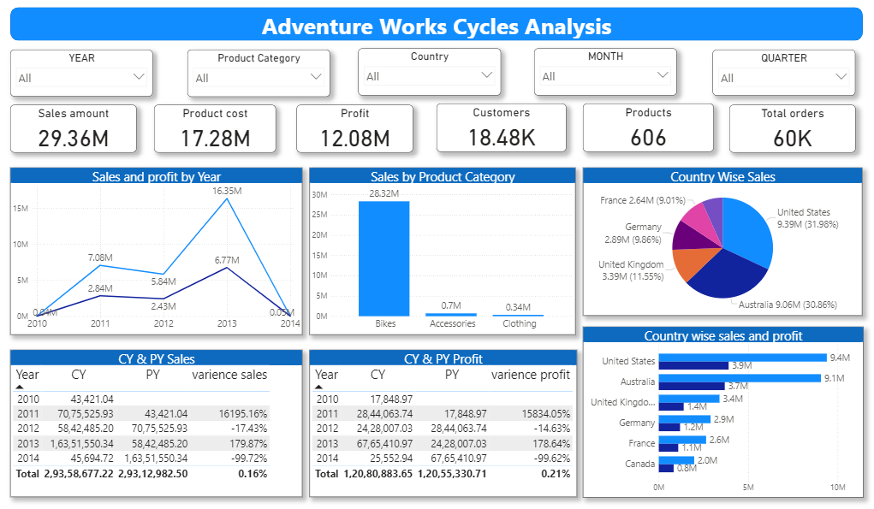

Slide 5
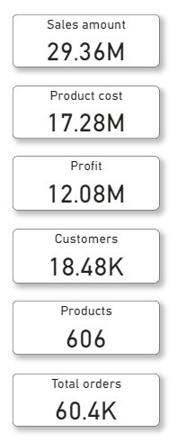
Overall Business KPIs
Key Performance Indicators
Sales Amount: $29.36M
Product Cost: $17.28M
Profit: $12.08M (41.2% profit margin)
Customers: 18.48K
Products: 606 unique items
Total Orders: 60.4K
Key Insights
Strong overall profitability with a 41.2% margin.
High product variety (606 items) catering to diverse customer needs.
Strong customer base generating significant order volume.

Slide 6
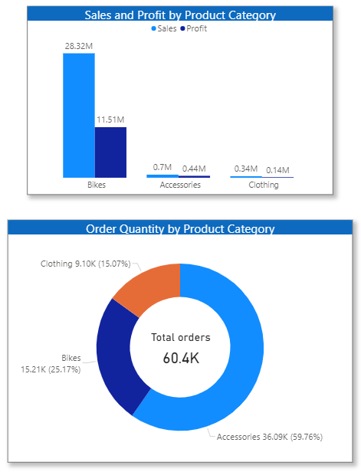
Product Category
Key Insights
Bikes: High sales (28.32M) and profit (11.51M), but lower order volume (25.17%).
Accessories: Largest orders (59.76%), moderate sales (0.7M), and profit (0.44M).
Clothing: Lowest across all metrics (15.07% orders, 0.34M sales, 0.14M profit).
Recommendations
Bikes: Promote premium models; target marketing to boost sales further.
Accessories: Improve pricing and bundling with Bikes to enhance profit.
Clothing: Introduce discounts or targeted campaigns to increase demand.
Cross-Selling: Bundle products (e.g., Bikes + Accessories) to drive overall revenue

Slide 7
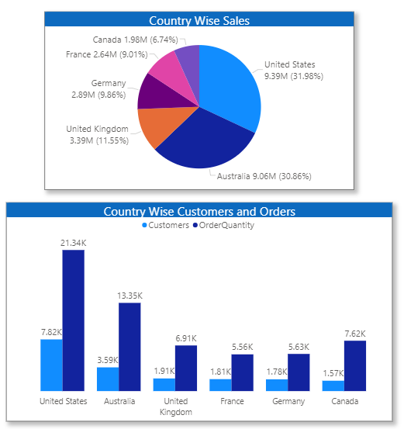
Country-Wise Sales Analysis
Key Insights
United States: Highest sales ($9.39M, 31.98%) and orders (21.34K). Strong customer base (7.82K).
Australia: Second-highest sales ($9.06M, 30.86%) and orders (13.35K).
United Kingdom, Germany, France: Moderate performance with growth potential.
Canada: Lowest sales ($1.98M, 6.74%) and customer engagement.
Recommendations
Expand High-Performing Regions:
Focus on the U.S. and Australia to maximize revenue.
Boost European Markets:
Target United Kingdom, Germany, and France with promotions and tailored campaigns.
Grow in Canada:
Run awareness campaigns and customer acquisition initiatives.

Slide 8
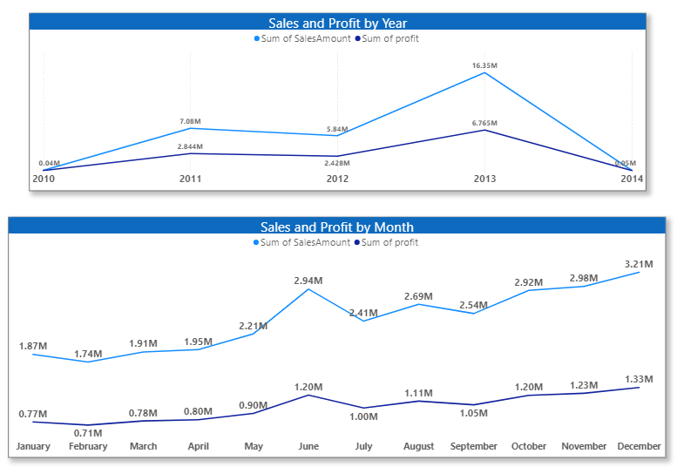
Sales and Profit Trends
Key Insights
Yearly Trends:
Significant growth in 2013, with the highest sales ($16.35M) and profit.
Monthly Trends:
Sales peaked in December ($3.21M) and June ($2.94M), suggesting seasonal demand.
Profit mirrors sales but shows stability in months like June and December.

Slide 9
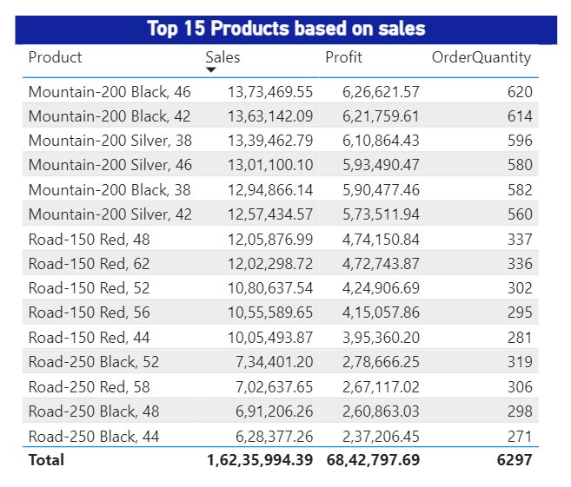
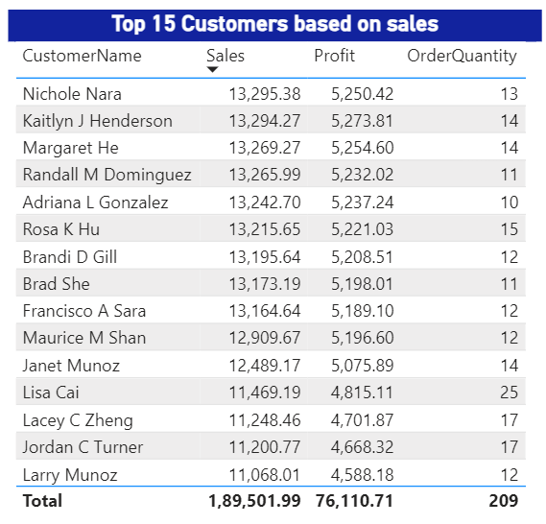
Top products & Customers

Slide 10
Strategic Implications:
Leverage High-Performing Products: Bikes should remain the primary focus for profit generation. Consider promoting premium models to sustain their profitability.
Revitalize Low-Profit Categories: Improve accessory and clothing profitability through strategies like cross-selling, bundling, or targeted marketing campaigns.
Operational Efficiency: Reassess cost structures for accessories and clothing to identify opportunities for cost reduction without compromising quality.
This approach can balance the product portfolio while maximizing overall profitability.

Slide 11


